Slide 1
PROJECT - IPL AUCTION

Slide 2
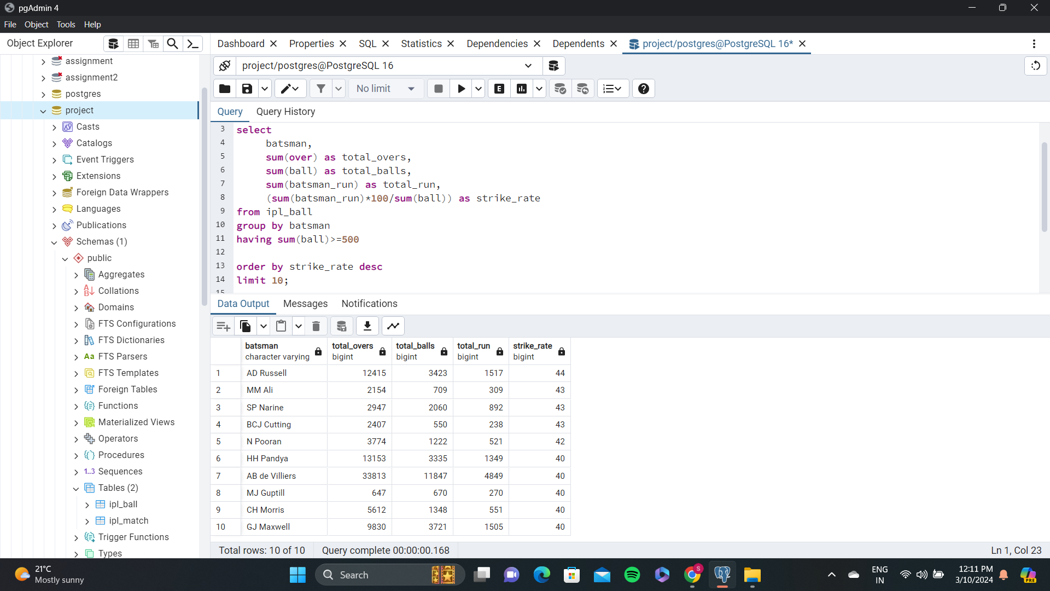
bidding on Batters :Aggressive batsmen Your first priority is to get 2-3 players with high S.R who have faced at least 500 balls . And to do that you have to make a list of 10 players you want to bid in the auction so that when you try to grab them in auction you should not pay the amount greater than you have in the purse for a particular player.
According to the question
2-3 high S.R players are :
AD Russell
MM Ali
SP Narine.
List of 10 Players with high S.R and atleast 500 balls faced are shown in the image.

Slide 3
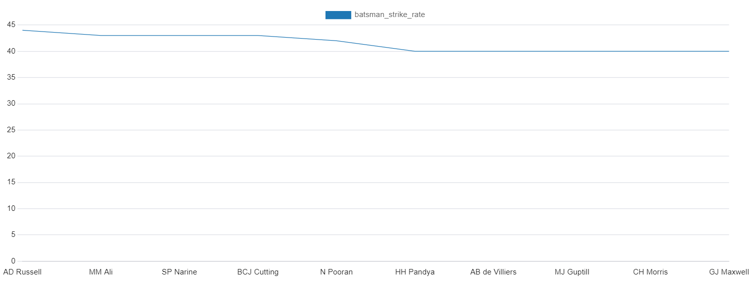
visual representation

Slide 4
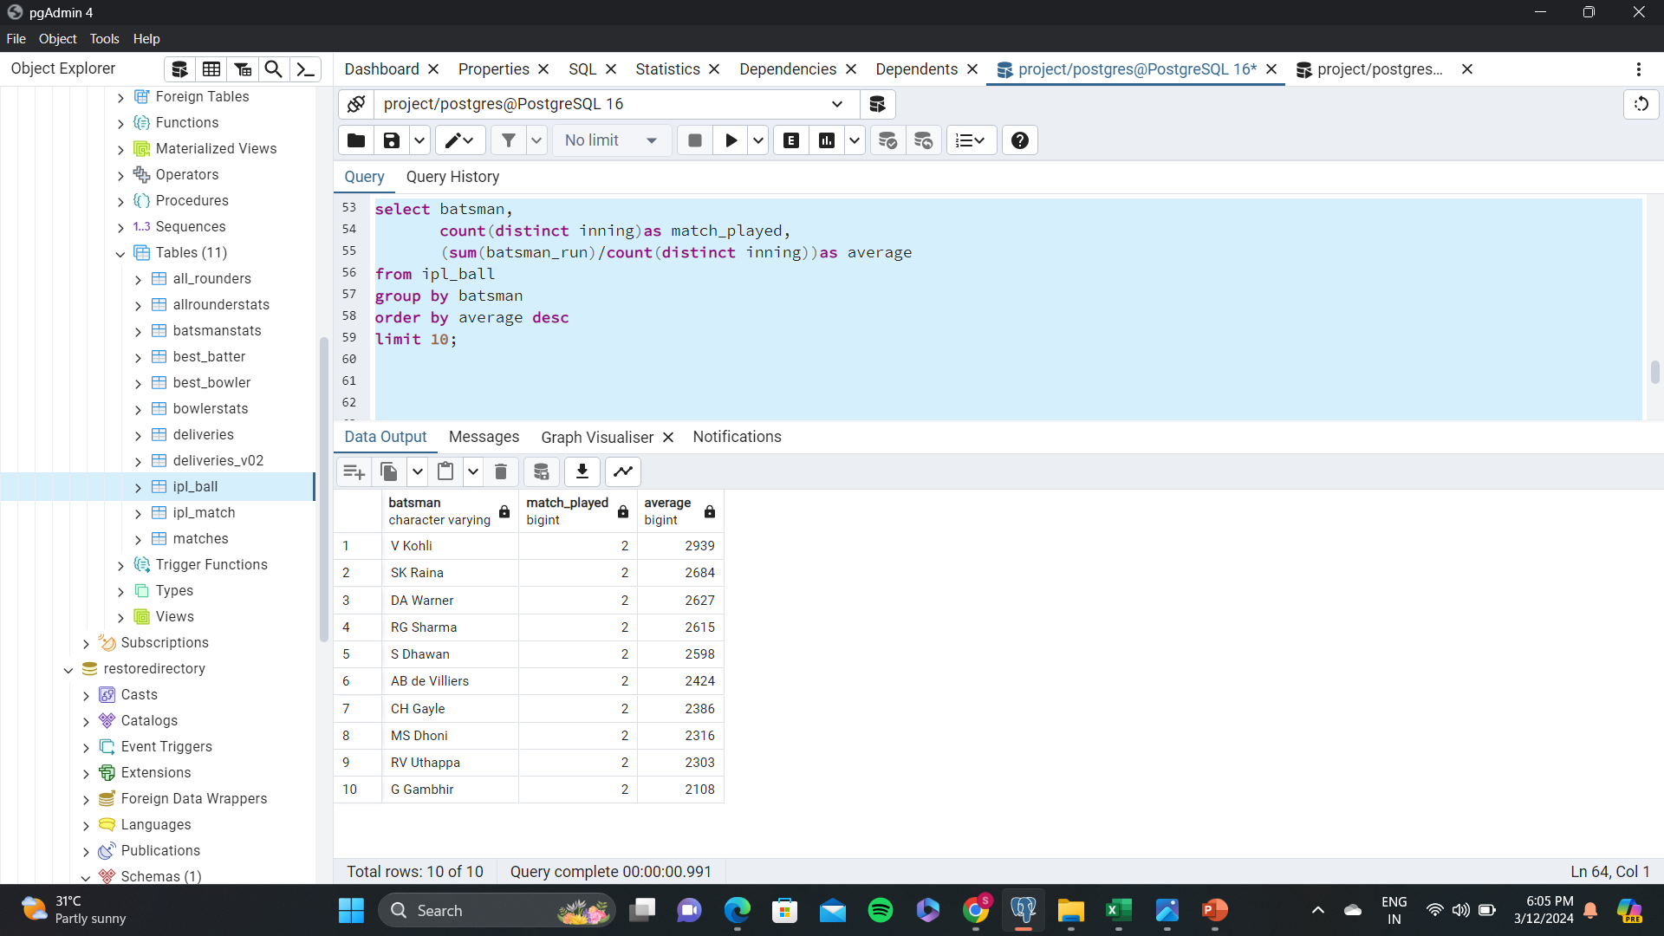
bidding on Batters : Anchor batsmen Now you need to get 2-3 players with good Average who have played more the 2 ipl seasons . And to do that you have to make a list of 10 players you want to bid in the auction so that when you try to grab them in auction you should not pay the amount greater than you have in the purse for a particular player.
According to the question
2-3 player with good average
V kholi
SK Raina
DA Warnar
List of 10 players with good average and played 2 ipl seasons is given in the image.

Slide 5
visual representation

Slide 6
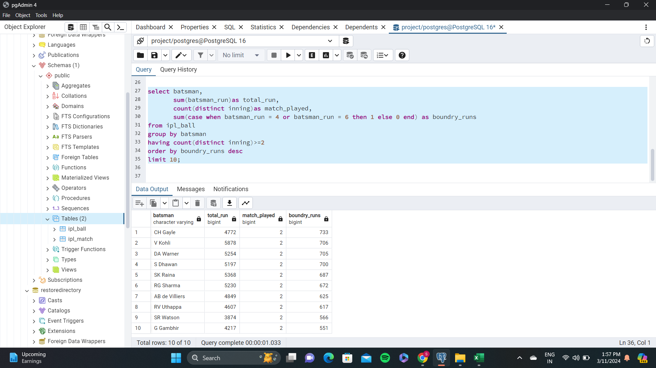
bidding on Batters : hard-hitters Now you need to get 2-3 Hard-hitting players who have scored most runs in boundaries and have played more the 2 ipl season. To do that you have to make a list of 10 players you want to bid in the auction so that when you try to grab them in auction you should not pay the amount greater than you have in the purse for a particular player.
According to the question
2-3 player who have scored most runs are
CH Gayle
V Kohli
DA Warner
List of 10 players who have played 2 ipl season is given in the image.

Slide 7
visual representation

Slide 8
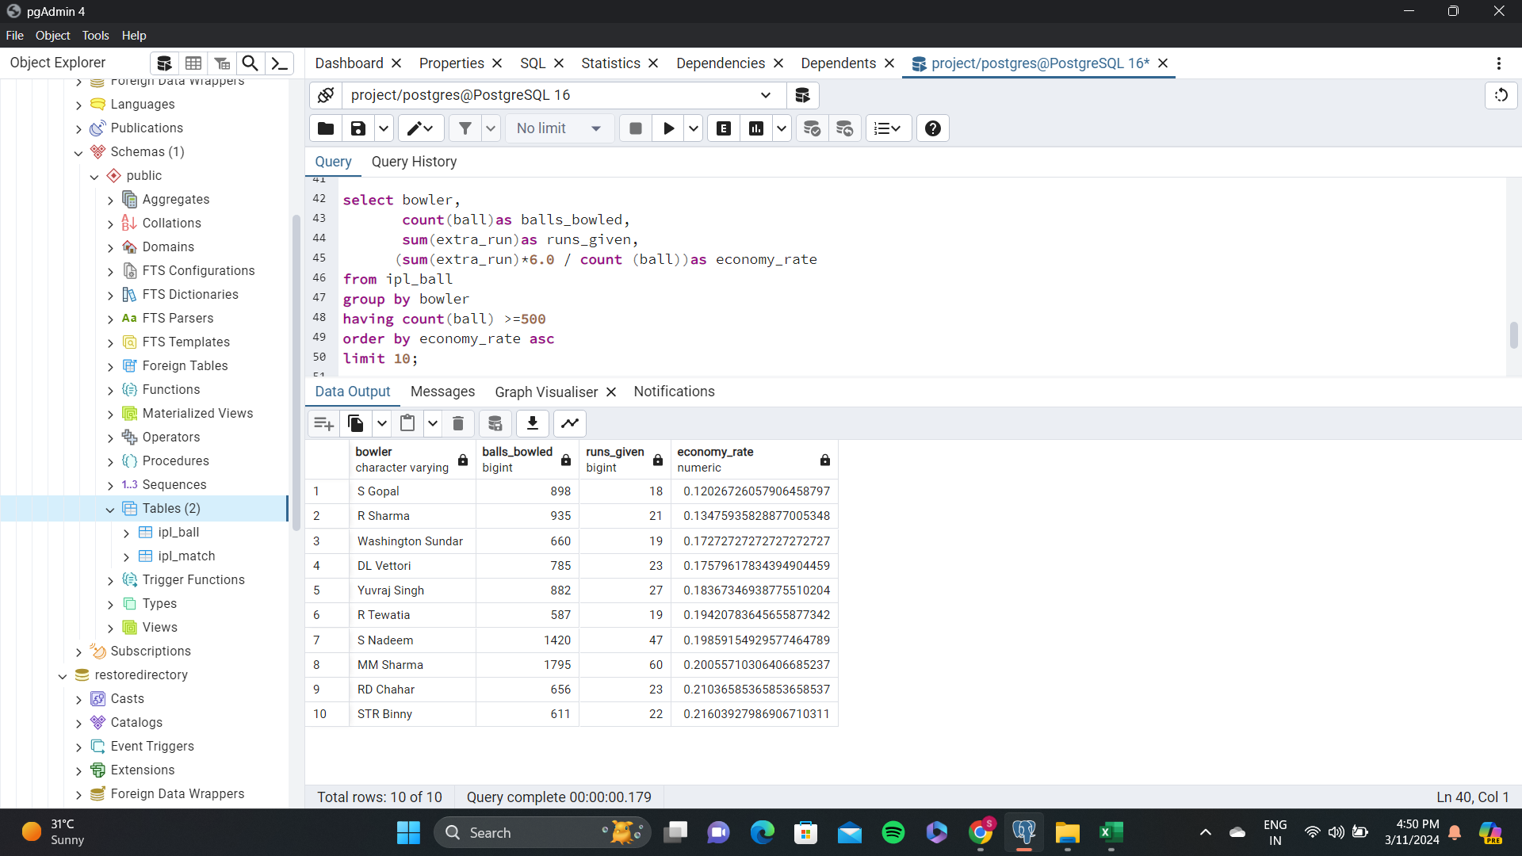
Bidding on Bowlers: Economical bowlers Your first priority is to get 2-3 bowlers with good economy who have bowled at least 500 balls in IPL so far . To do that you have to make a list of 10 players you want to bid in the auction so that when you try to grab them in auction you should not pay the amount greater than you have in the purse for a particular player.
According to the question
2-3 bowlers with good economy rate are
S Gopal
R Sharma
Washington Sundar
List of 10 Players with high S.R and atleast bowled 500 balls are shown in the image.

Slide 9
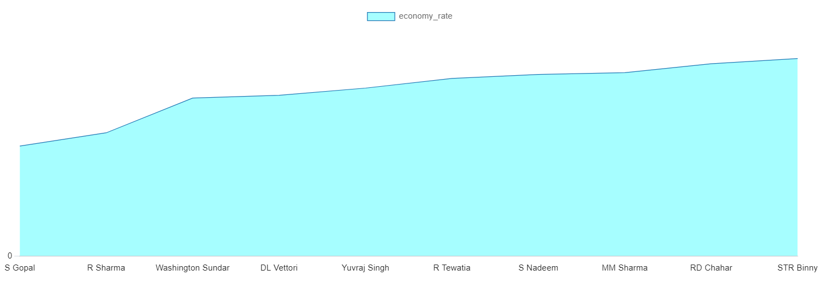
visual representation

Slide 10
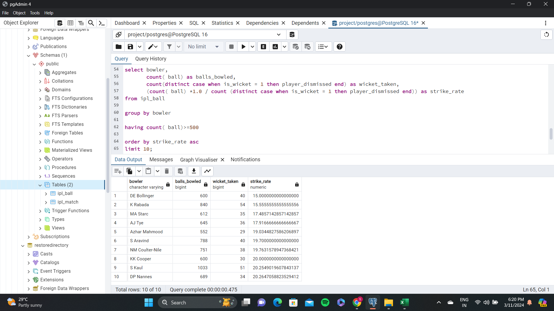
Bidding on Bowlers: wicket taking bowlers Now you need to get 2-3 bowlers with the best strike rate and who have bowled at least 500 balls in IPL so far . To do that you have to make a list of 10 players you want to bid in the auction so that when you try to grab them in auction you should not pay the amount greater than you have in the purse for a particular player.
According to the question
2-3 bowlers with best S.R are
DE Bollinger
K Rabada
MA Starc
List of 10 bowlers how have bowled atleast 500 balls is shown in the image.

Slide 11
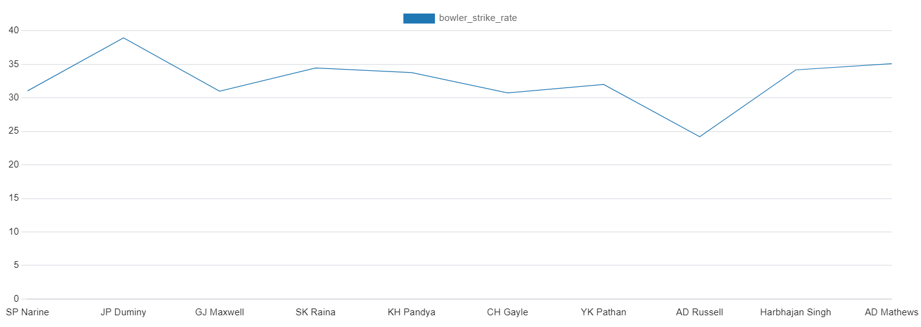
visual representation

Slide 12
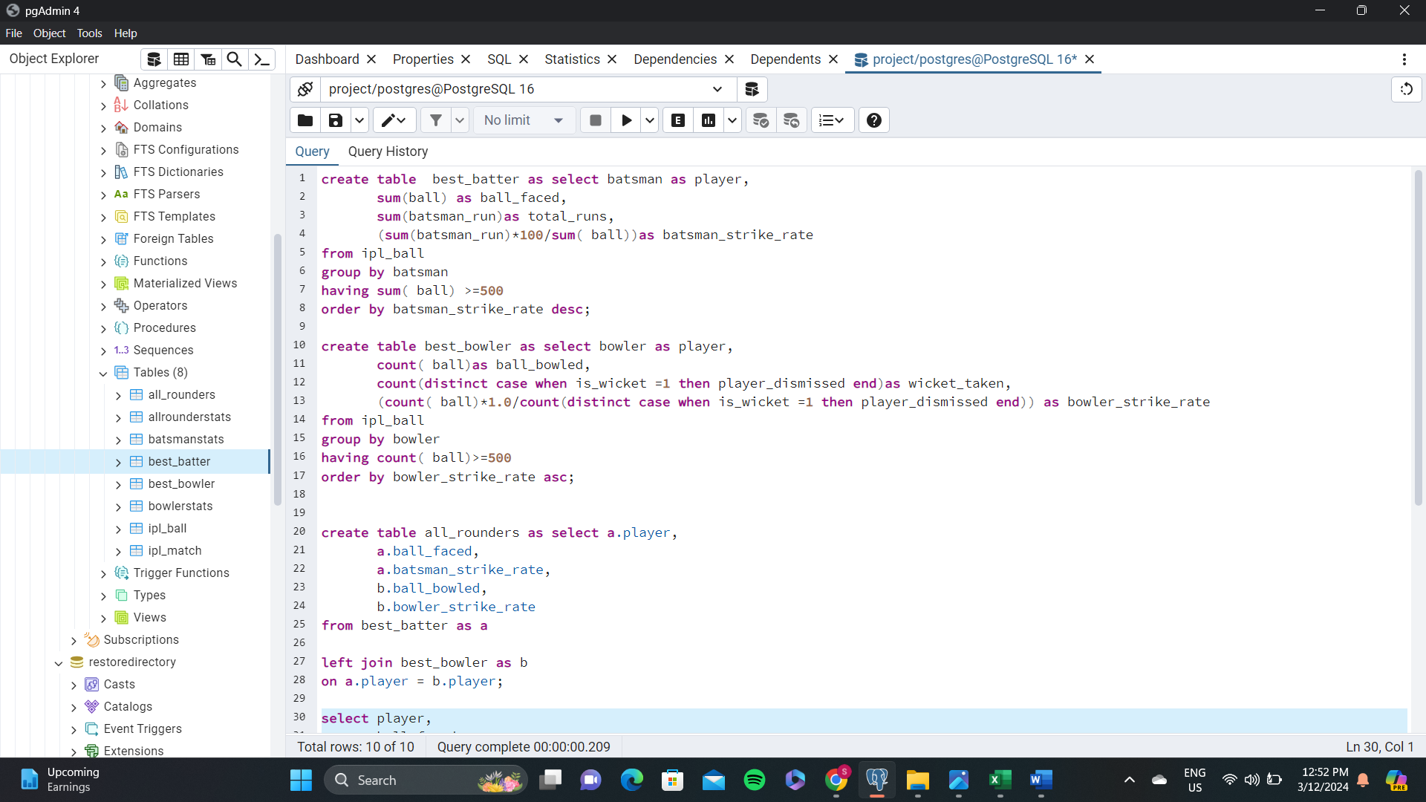
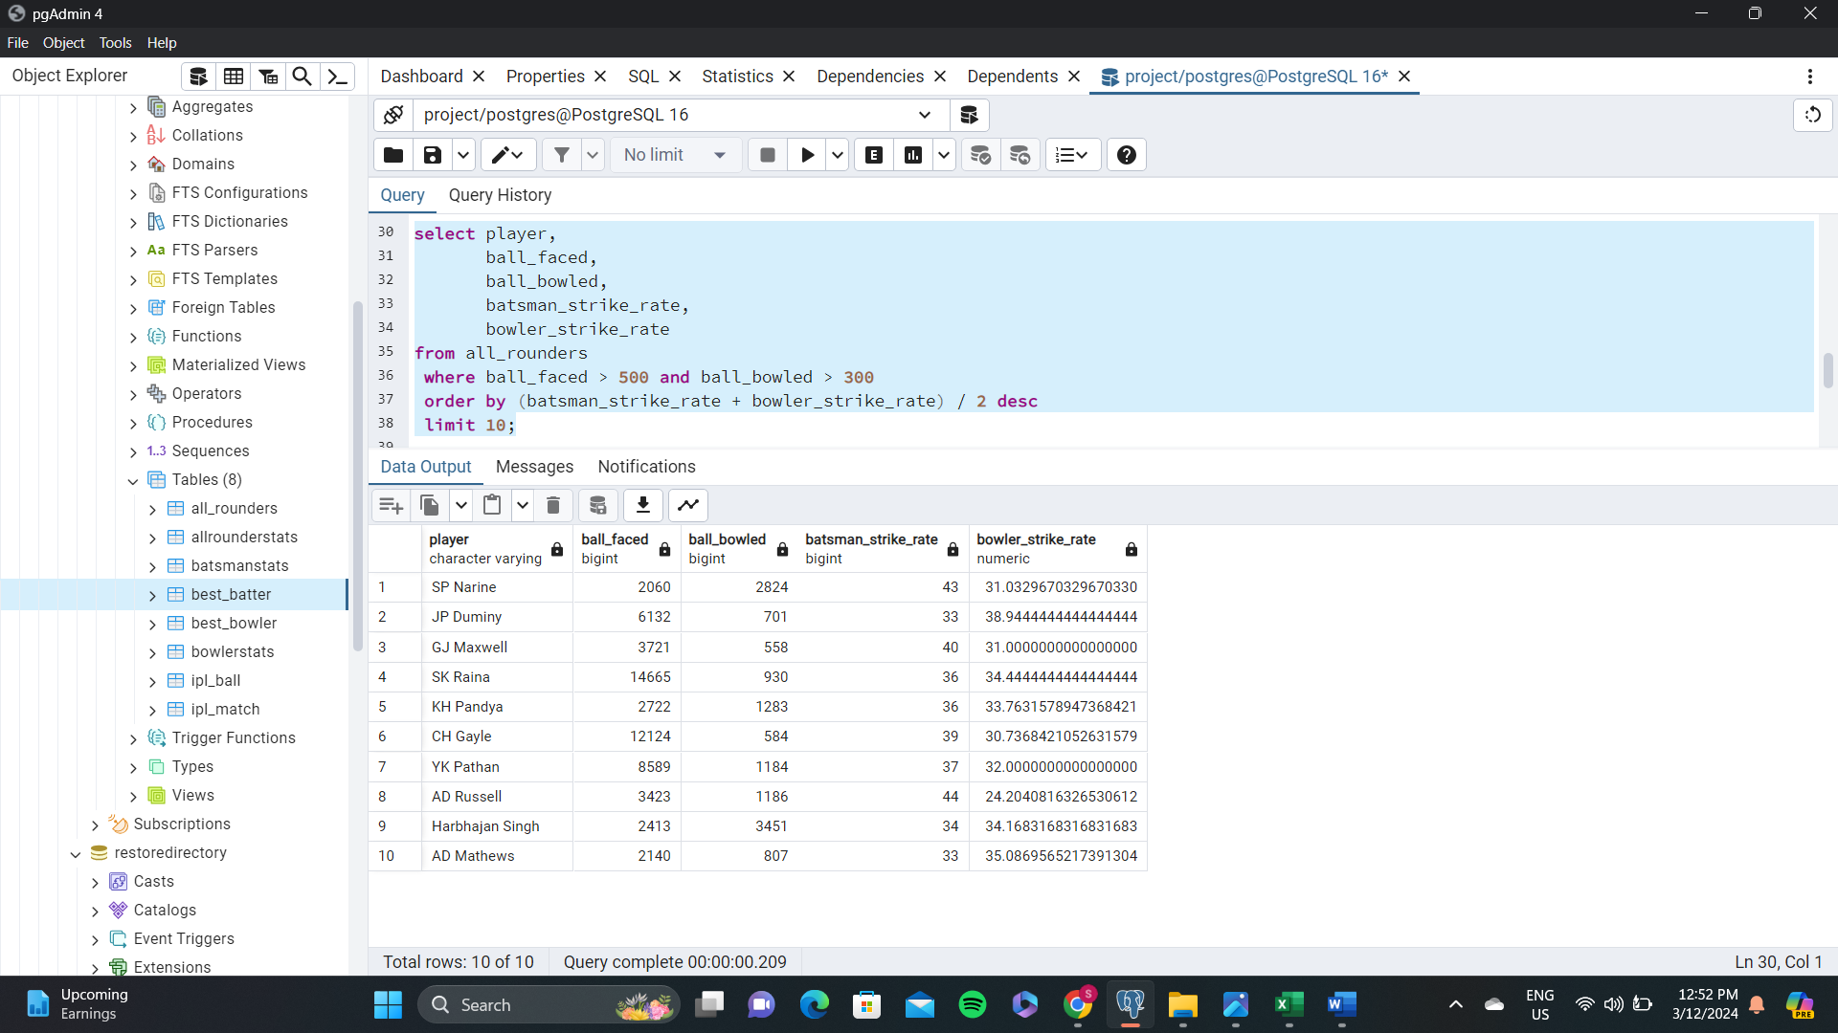
Bidding on : all rounders Now you need to get 2-3 All rounders with the best batting as well as bowling strike rate and who have faced at least 500 balls in IPL so far and have bowled minimum 300 balls . To do that you have to make a list of 10 players you want to bid in the auction so that when you try to grab them in auction you should not pay the amount greater than you have in the purse for a particular player.

Slide 13
visual representation

Slide 14
the wicketkeeper is an important member of a T20 team and can have a significant impact on the outcome of a match. Now suppose you are provided with a list of wicketkeeper names, and your task is to define the criteria for choosing the two best wicketkeepers from all those names . Try to define a criteria best suited for a wicketkeeper required in a t20 team so that your team will be complete and have everything required for winning this year’s IPL.
The criteria :
1. Batting Performance:
Average Strike Rate: A higher strike rate indicates the ability to score runs quickly.
Batting Average: A good batting average reflects consistency in scoring.
2. Wicketkeeping Skills:
Average Catches per Match: Indicates the fielding ability, especially catches taken per match.
Average Stumpings per Match: Reflects proficiency in stumping opportunities.
Select
wicketkeeper,
avg(batting_strike_rate) as avg_strike_rate,
avg(batting_average) as avg_batting_average,
avg(catches_per_match) as avg_catches_per_match,
avg(stumpings_per_match) as avg_stumpings_per_match
from
wicketkeepers_record
where
matches_played >= 20
group by
wicketkeeper
order by
(avg_strike_rate + avg_batting_average + avg_catches_per_match + avg_stumpings_per_match) desc
limit 2;

Slide 15
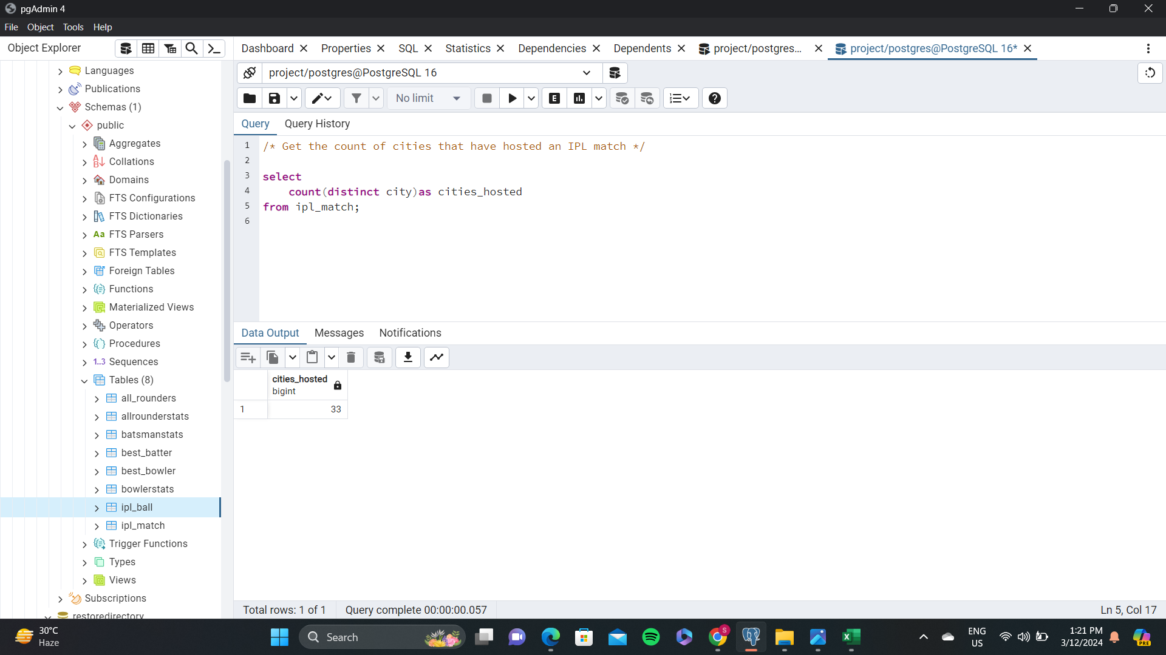
Additional Questions for Final Assessment--1

Slide 16
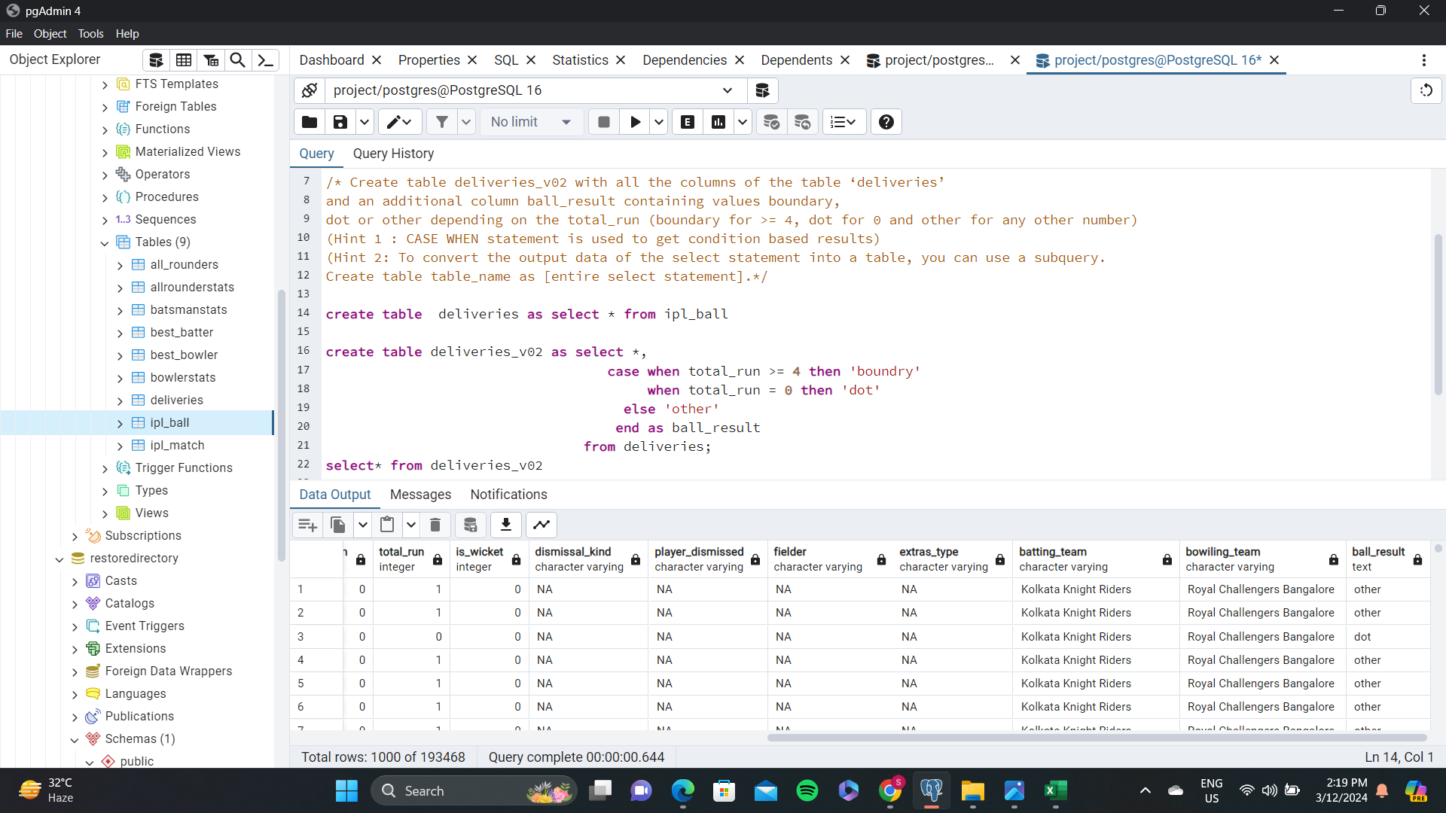
Additional Questions for Final Assessment--2

Slide 17
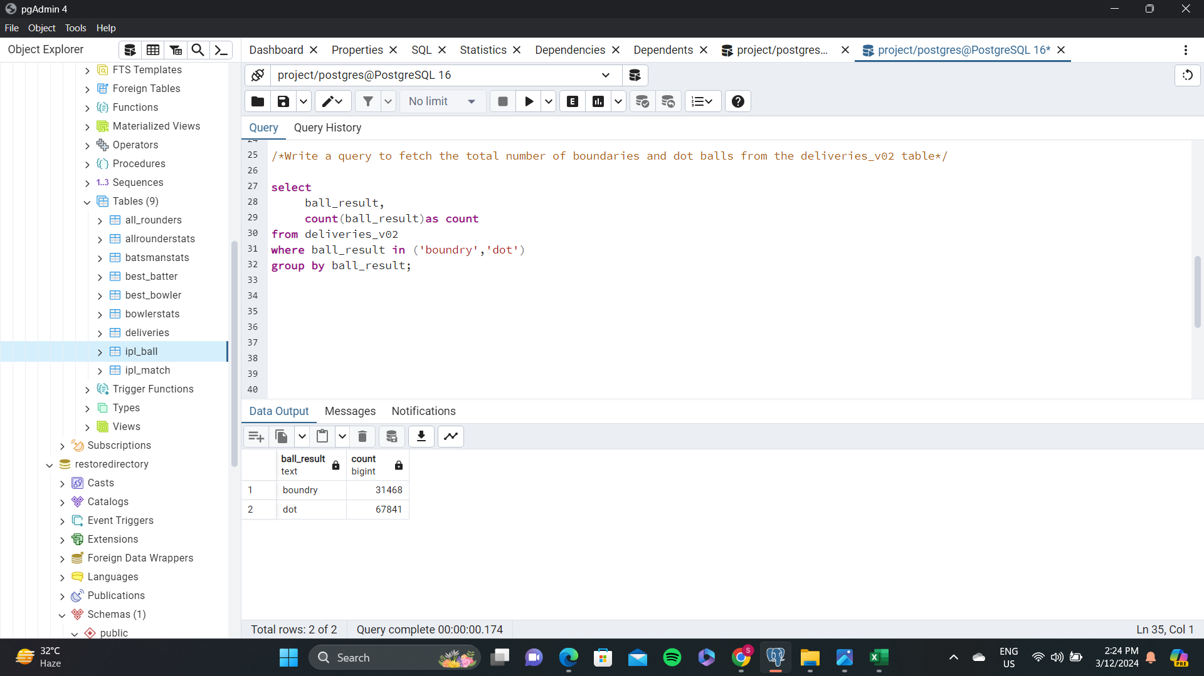
Additional Questions for Final Assessment--3

Slide 18
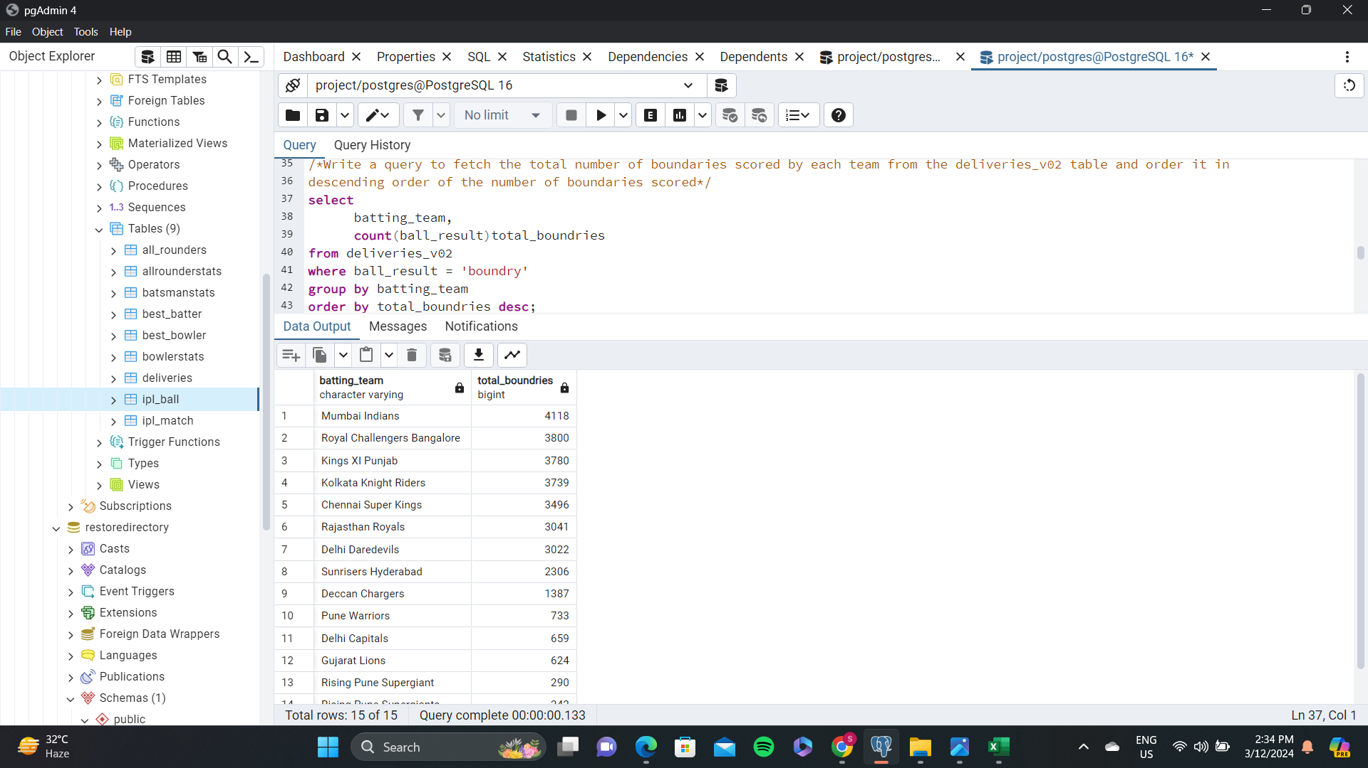
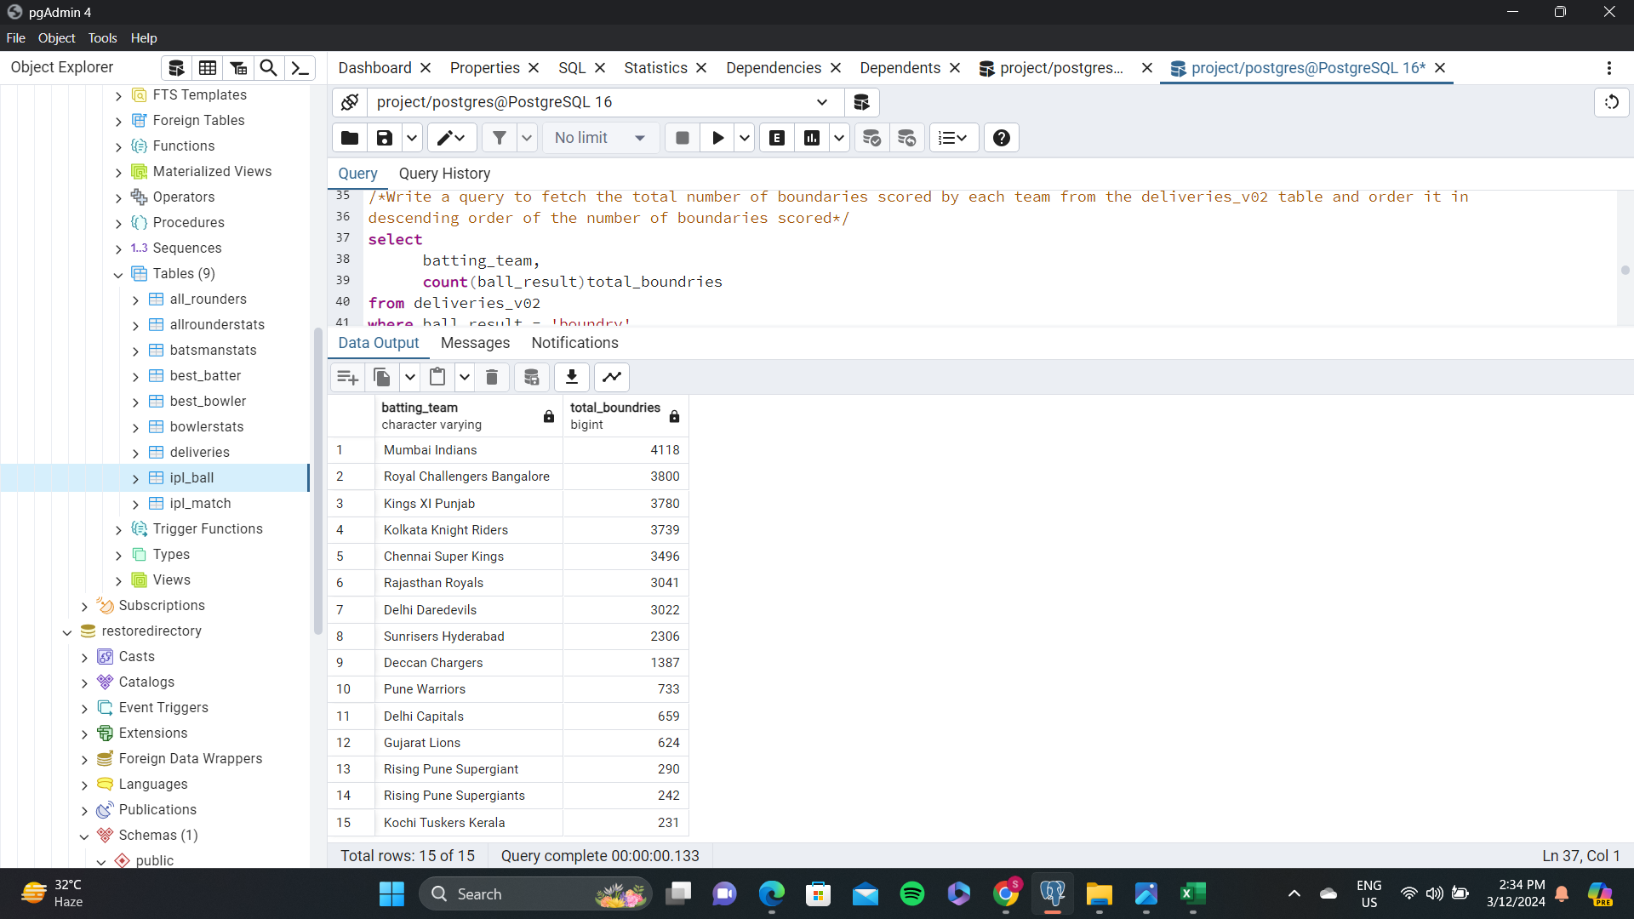
Additional Questions for Final Assessment--4

Slide 19
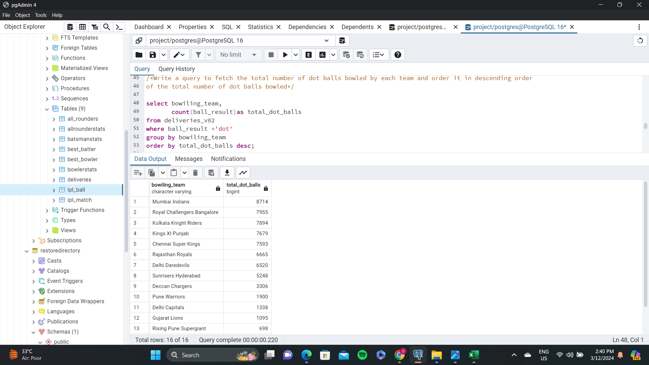
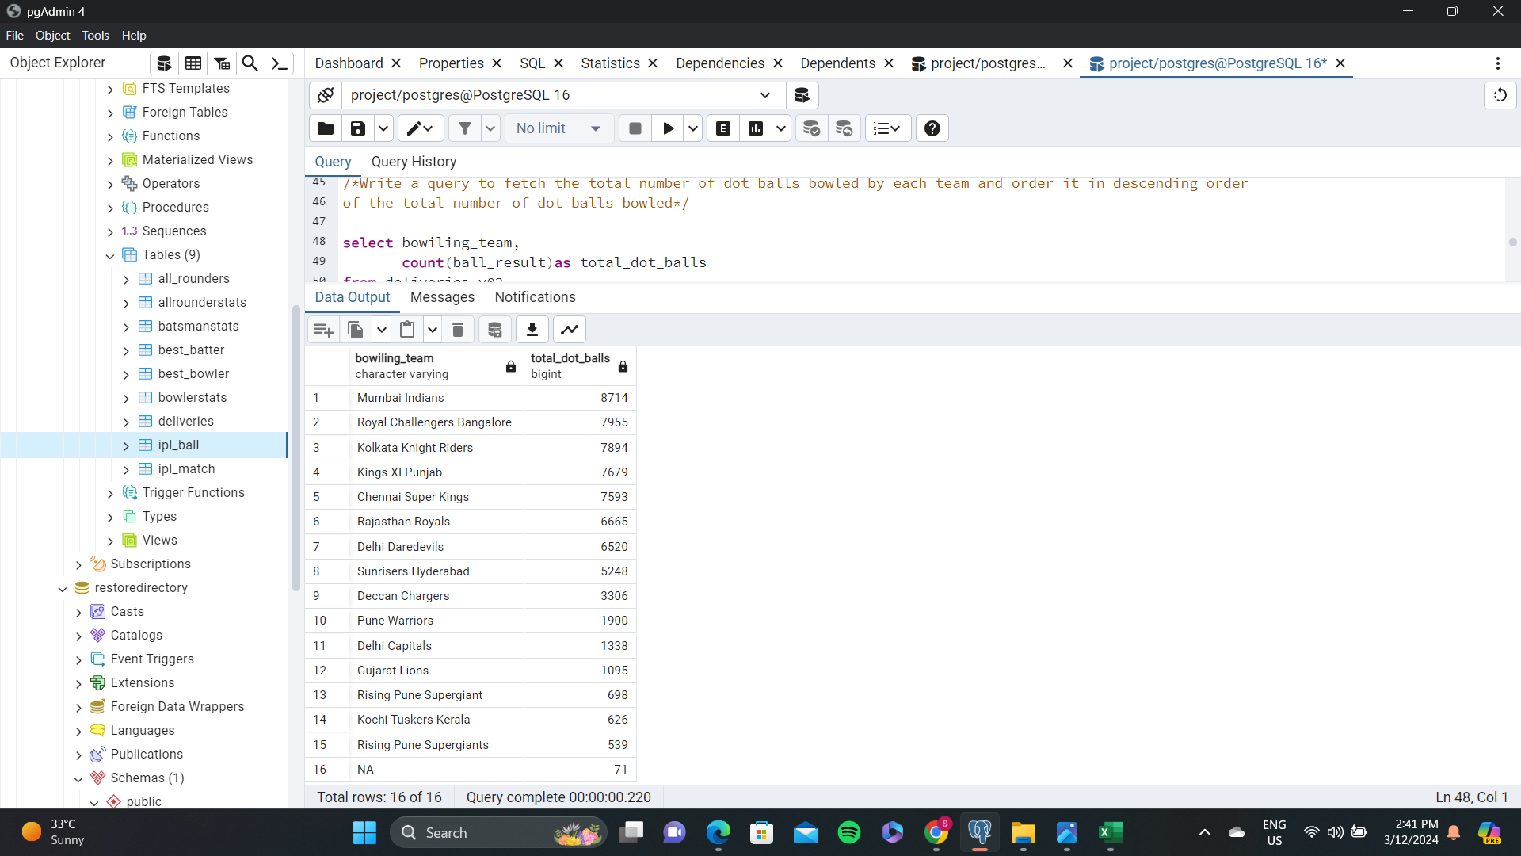
Additional Questions for Final Assessment--5

Slide 20
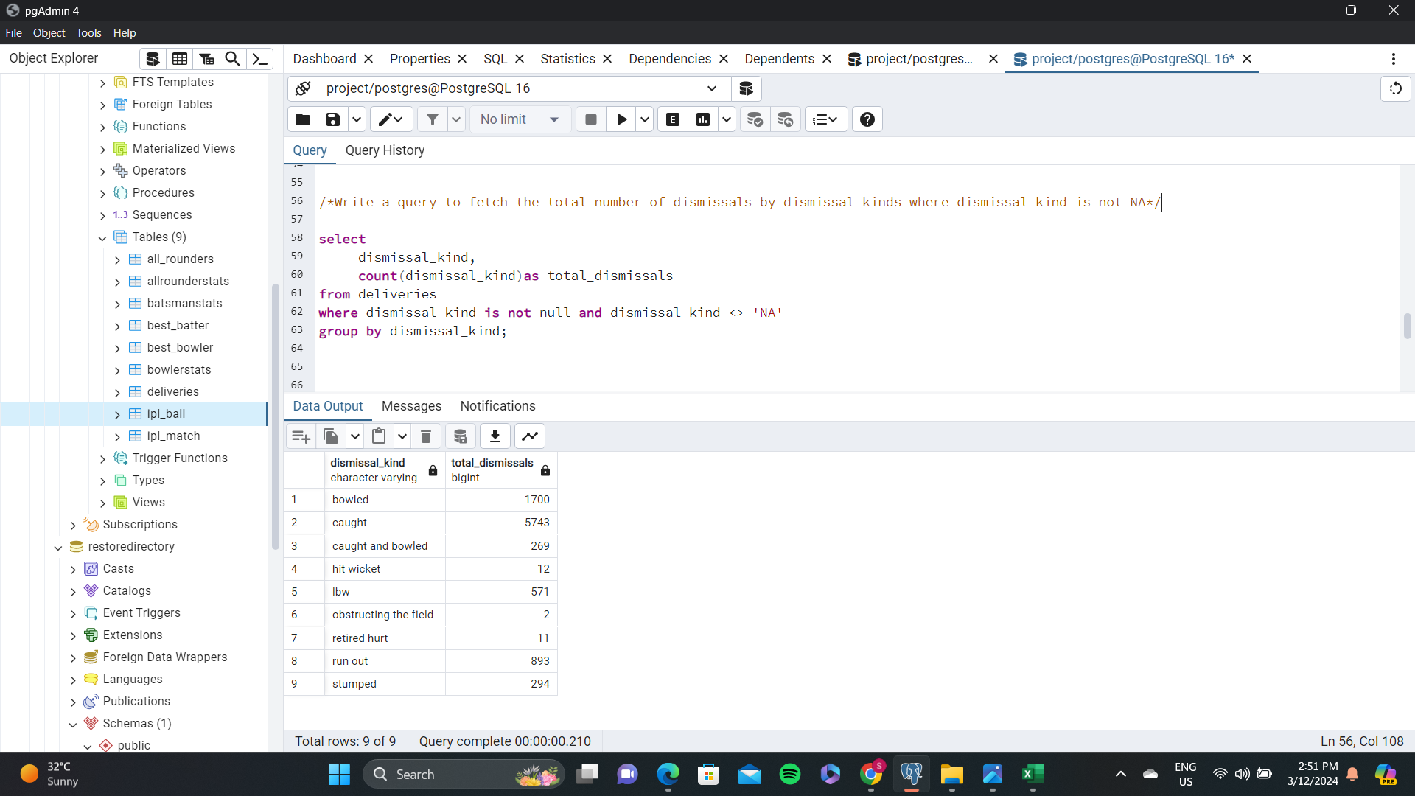
Additional Questions for Final Assessment--6

Slide 21
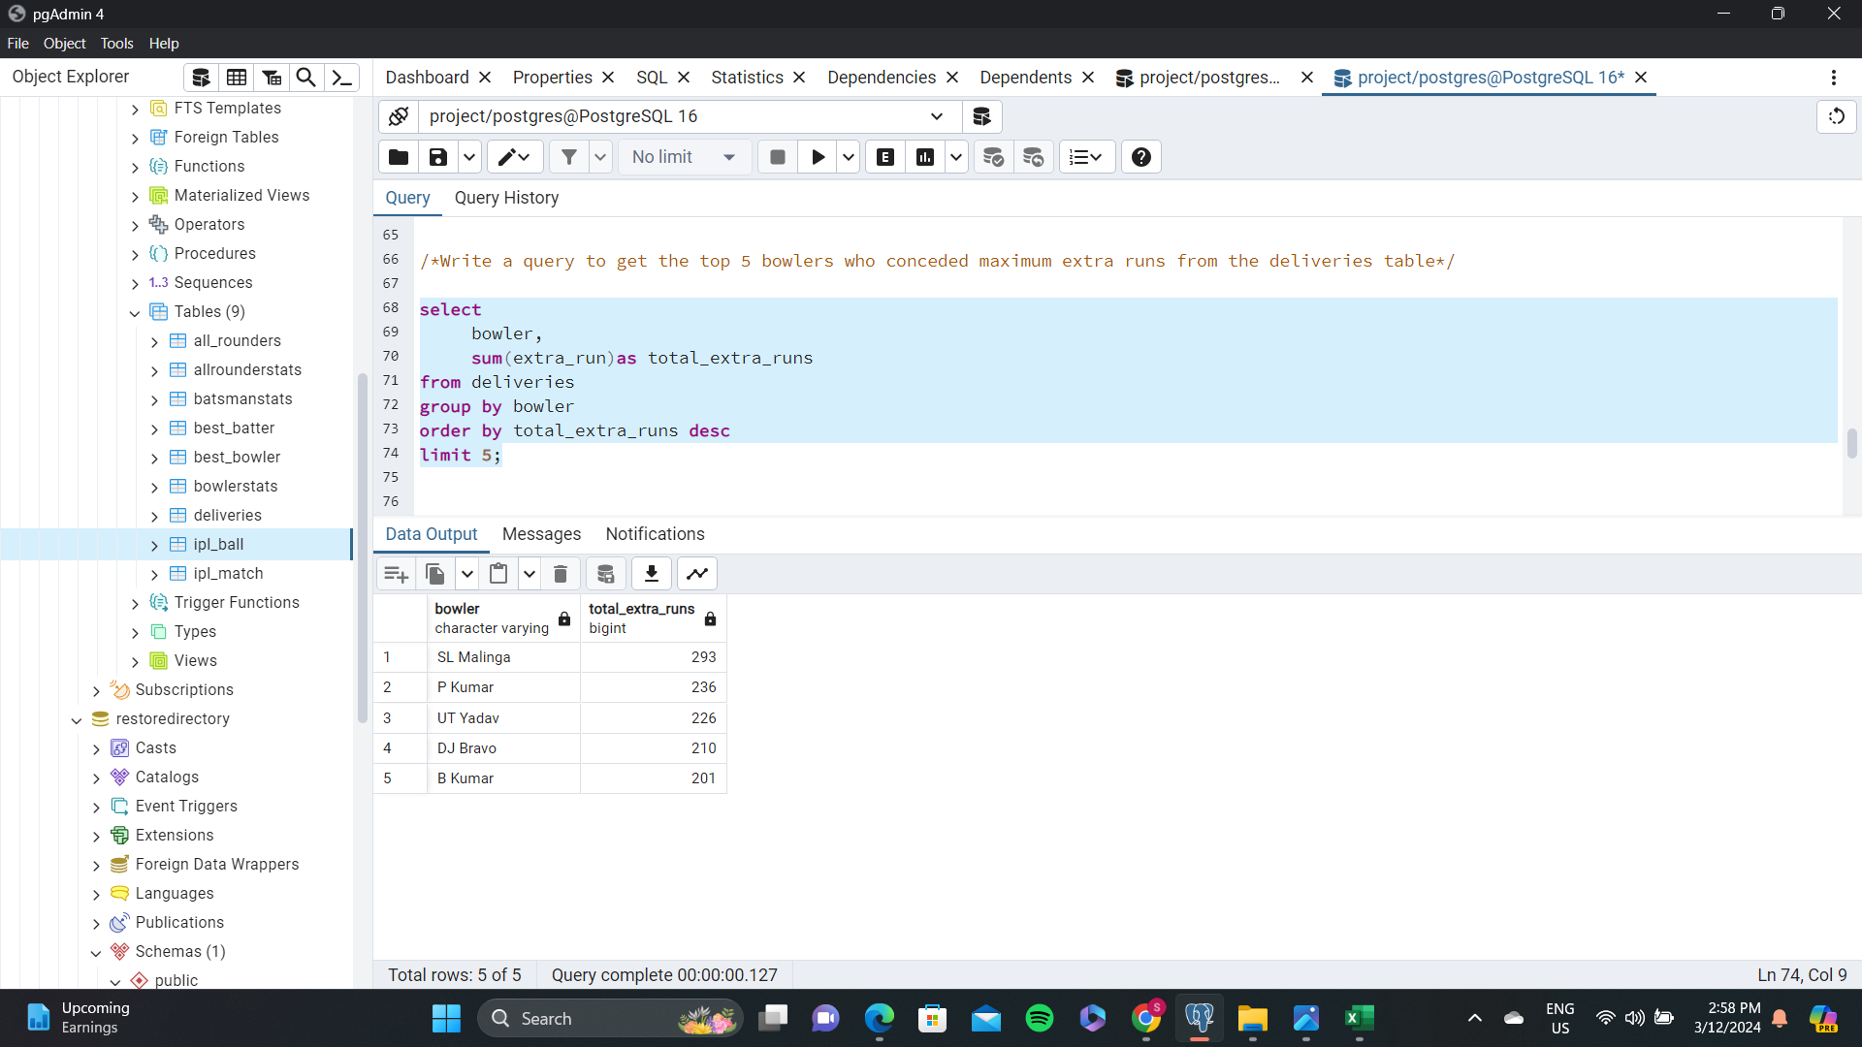
Additional Questions for Final Assessment--7

Slide 22
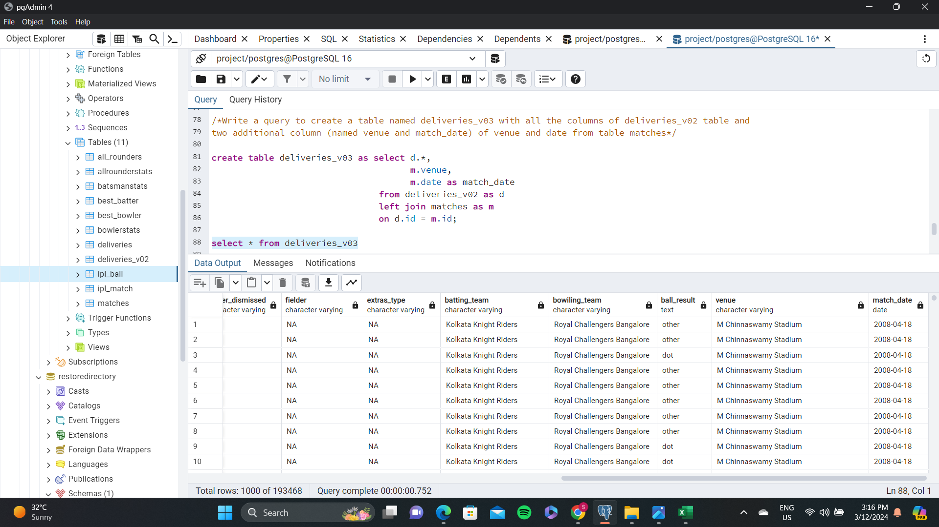
Additional Questions for Final Assessment--8

Slide 23
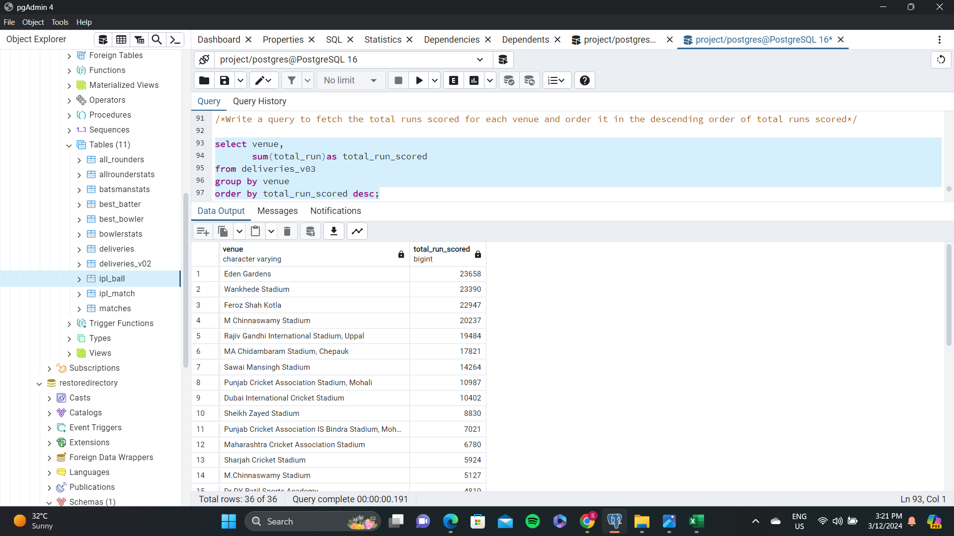
Additional Questions for Final Assessment--9

Slide 24
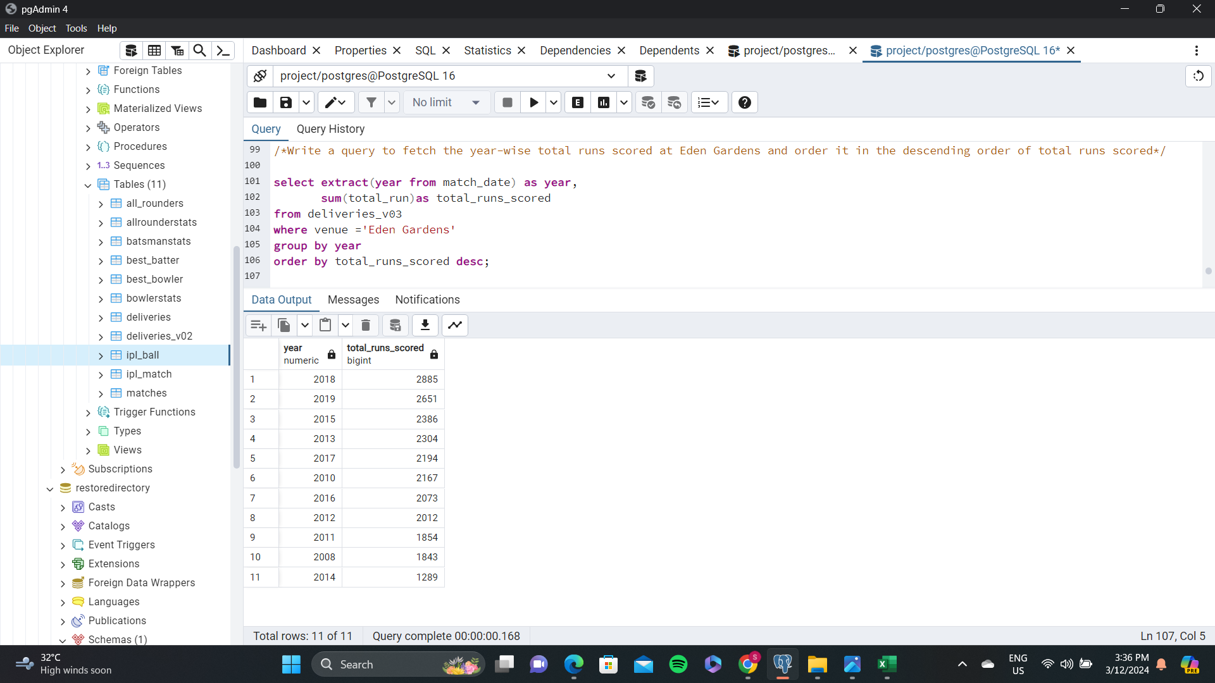
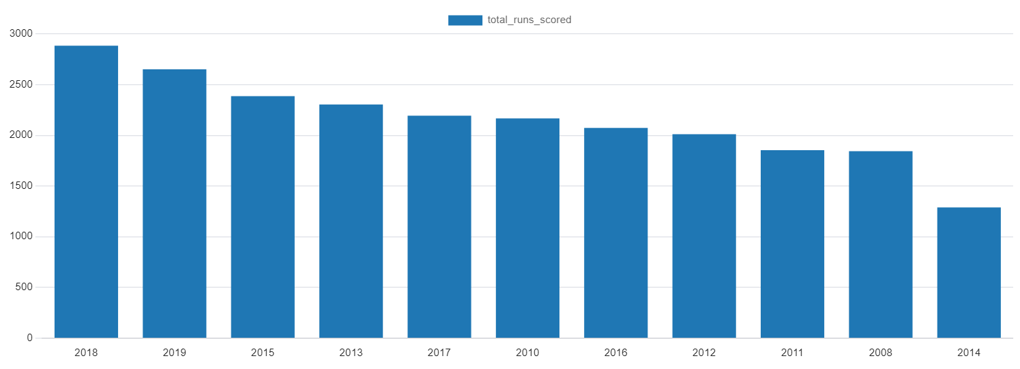
Additional Questions for Final Assessment--10

